Slide 1
The Battle of Neighborhoods
Mariano Puga

Slide 2
Description of the Problem and Background
I'm currently working in Santiago (Chile, a small country in south America for those who don't know), but I’m evaluating the possibility of studying an MBA overseas. I'm a huge surfing fan so I'd love to combine a city big enough to do so and also stay close to the ocean.
The first place I thought of in order to do this was Melbourne, Australia. My main concerns regarding accommodation would be the following:
Easy access to the surf spots.
Residential Apartment in order to share it (3 bedrooms)
Desirable to have venues such as coffee shops, green areas and gym’s.
Rent shouldn't be too high, but infrastructure should be good.

Slide 3
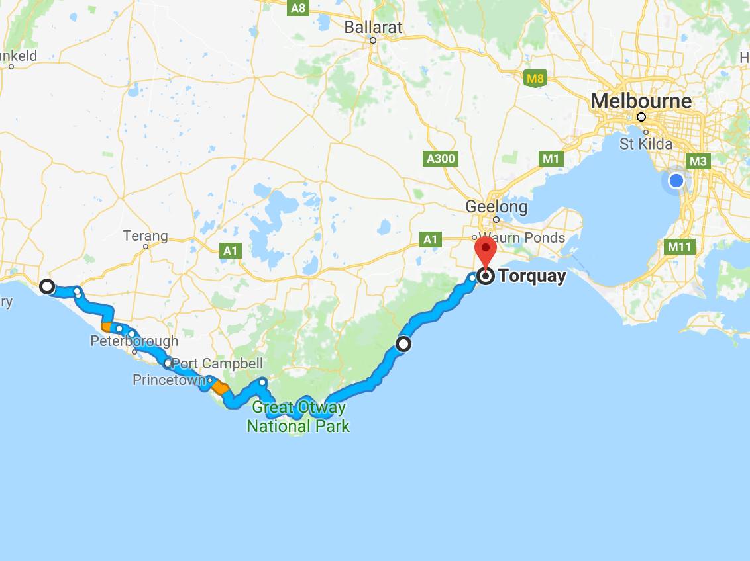
Great Ocean Road
The best surfing spots in this side of Australia are located in something that is called the great ocean road.
In order to access this part of the coastline one should drive from Melbourne to Torquay, or in my case if I’m traveling alone I’d probably use public transportation.

Slide 4
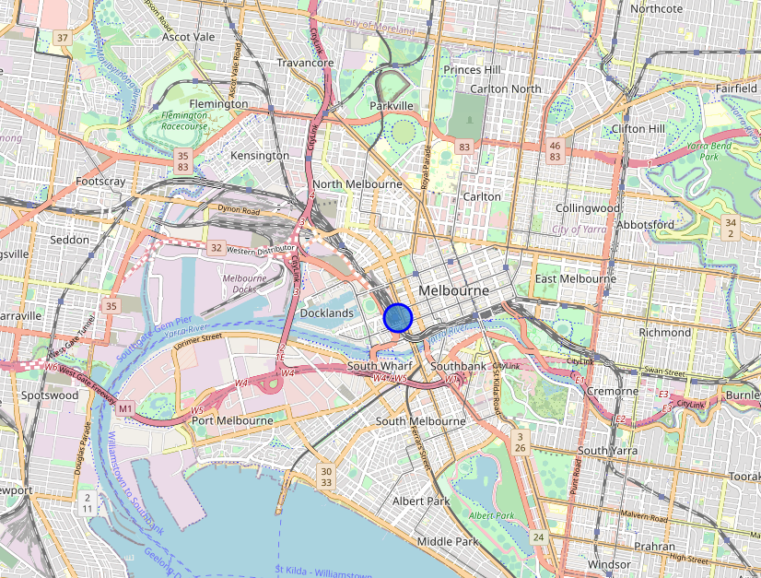
Access to surfing
Southern Cross Station is located in Docklands, so in order to go surfing I should stay close to this area

Slide 5
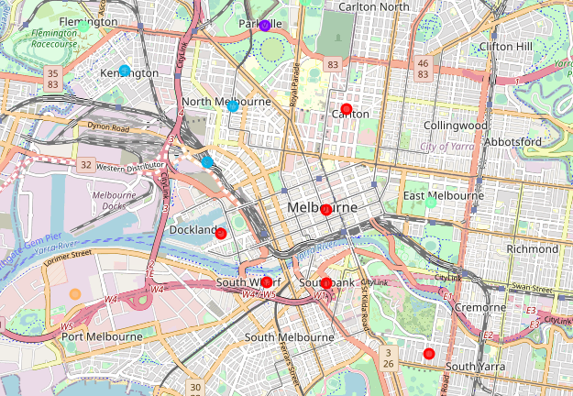
Access to surfing
Considering this, we immediately leave out of the conversation the following suburbs:
Kensington.
Parkville.
Flemington.
Carlton North.
Port Melbourne.
Docklands (also stays out given the noise of the train station).

Slide 6
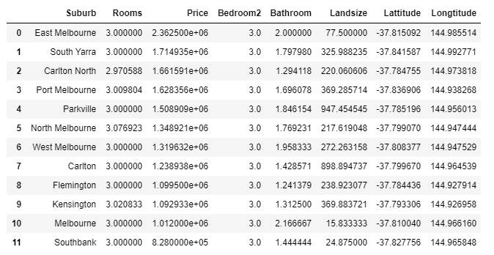
Accommodation
I filtered the different suburbs of Melbourne by calculating the average price of a 3 bedroom accommodation.
The table shows the price in descending order, leaving us with the following order:
1. North Melbourne
2. West Melbourne
3. Carlton
4. Melbourne
5. Southbank
Given the low price on Southbank I’d leave it out,
probably has the least appealing infrastructure.

Slide 7
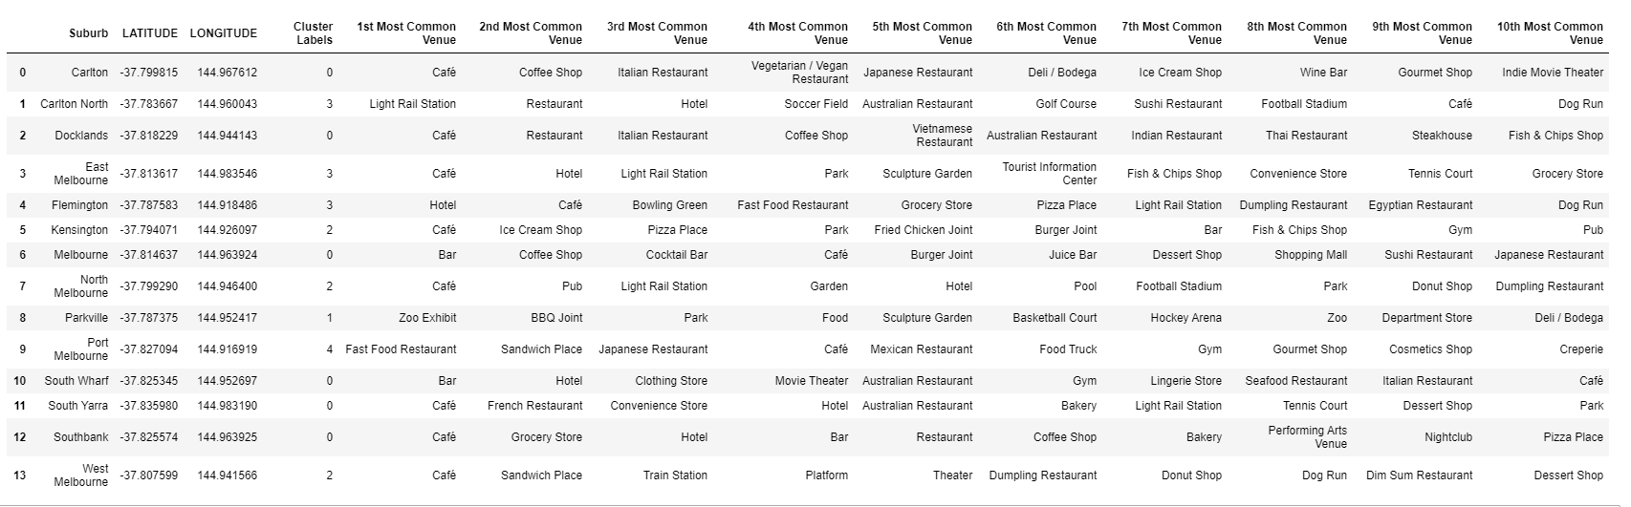
Venues

Slide 8
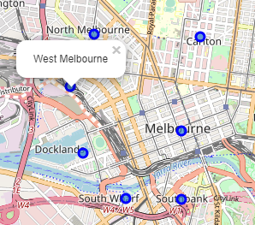
Venues
Based on the venues, let’s characterize our finalists:
1. North Melbourne: The most expensive, has good coffee, pubs, light rail station, garden, pool, football stadium, park.
2. West Melbourne: Almost as pricy as North Melbourne, has good coffee, train station, a theater and dumplings/dim sum.
3. Carlton: Seem bohemian, lots of restaurant (I prefer cooking to be honest), does have good coffee.
4. Melbourne: Restaurants, coffee, bars, shopping mall.

Slide 9
Results
Given my own particular preferences I’d probably go for either North or West Melbourne.
North Melbourne is the most expensive out of the candidates but it’s not by much. It has green areas and good coffee that for me is a must. Its also close to the train station.
West Melbourne would be my second pick, its close to North Melbourne (park/green areas) and closer to the train station, has good street food that I tend to buy more than restaurants and even has a theater.
Given this and all the reasons mentioned before I’d pick North Melbourne, followed closely by West Melbourne.

